Slide 1
Readahead
장유진

Slide 2
Kernel 버전확인
KCC 2018
Kernel 4.4.0-31-generic

Slide 3
max_sectors
KCC 2018
max_sectors가 define 된 위치
/drivers/scsi/megaraid/megaraid sas base.c
/drivers/scsi/mpt3sas/mpt3sas_scsih.c

Slide 4
/drivers/scsi/megaraid/megaraid sas base.c
KCC 2018
static int megasas_init_fw(struct megasas_instance *instance)
//u32 max_sectors_1, max_sectors_2
//둘중 min 값이 tmp_sectors이됨
//struct megasas_instance의 max_sectors_per_req로 tmp_setors가 보내짐
static int megasas_io_attach(struct megasas_instance *instance)
//struct Scsi_Host의 max_sectors로 struct megasas_instance의 max_sectors_per_req의 값 이 보내짐

Slide 5
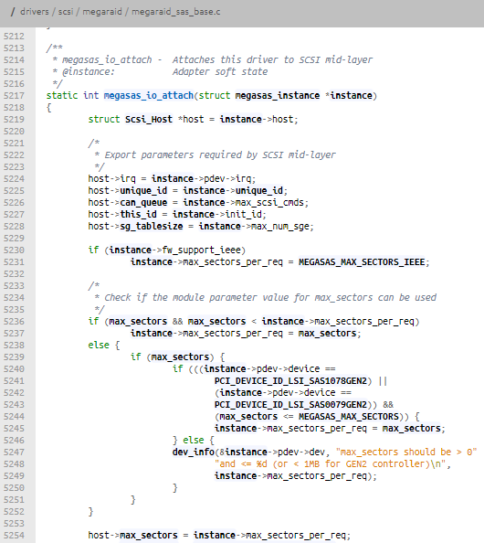
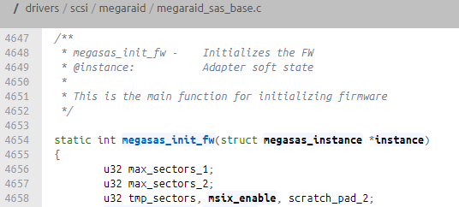
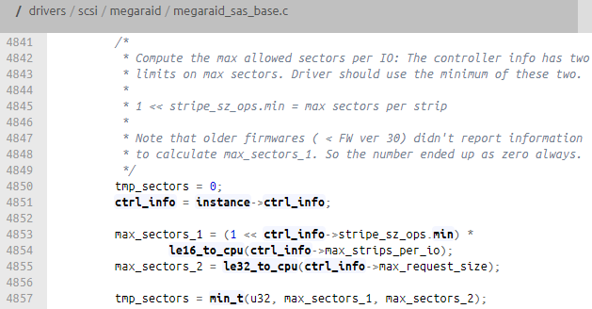
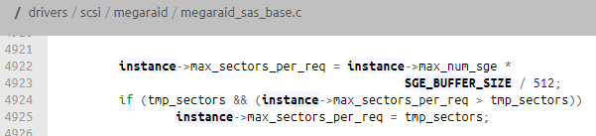

Slide 6
/drivers/scsi/mpt3sas/mpt3sas_scsih.c
KCC 2018
static struct scsi_host_template
//mpt2sas_driver_template, mpt3sas_driver_tmpemplate
//.max_sectors = 32767 (0x3FFF)
int _scsih_probe(struct pci_dev *pdev, const struct pci_device_id *id)
//struct Scsi_Host 의 max_sectors로 max_sectors 넣고 pr_info함수 들어감

Slide 7
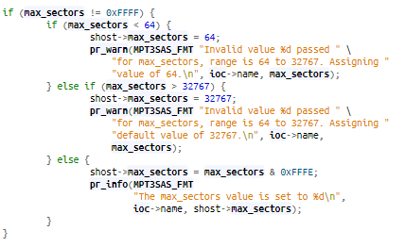

Slide 8
/include/scsi/scsi_host.h
KCC 2018
struct scsi_host_template
struct Scsi_Host

Slide 9
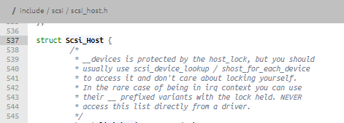

Slide 10
readahead
KCC 2018
readahead가 define 된 위치
/drivers/md/bcache/sysfs.c
새로운 ahead window size 결정하는 곳
/mm/readahead.c

Slide 11
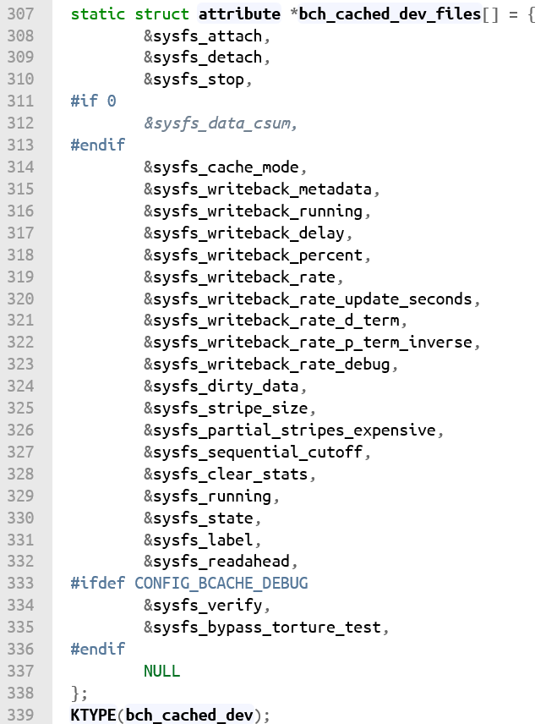
/drivers/md/bcache/sysfs.c
KCC 2018

Slide 12
/drivrers/md/bcache/bcache.h
KCC 2018
struct cached_dev

Slide 13
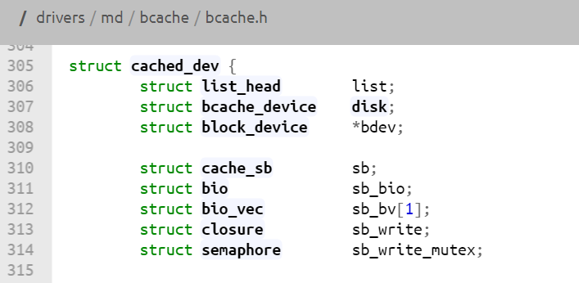
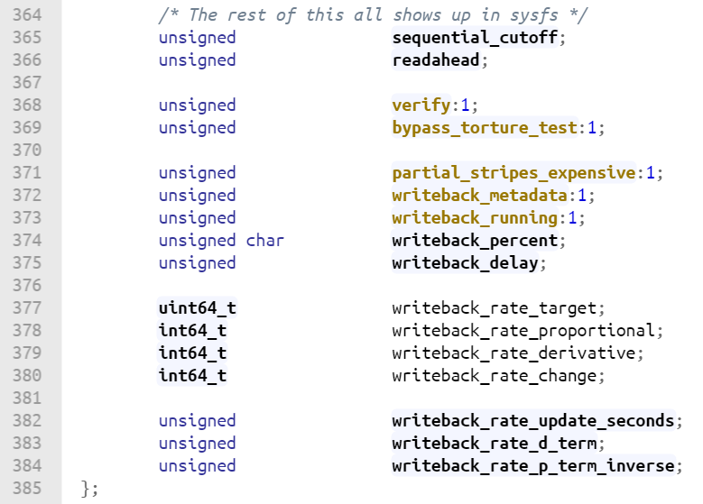

Slide 14
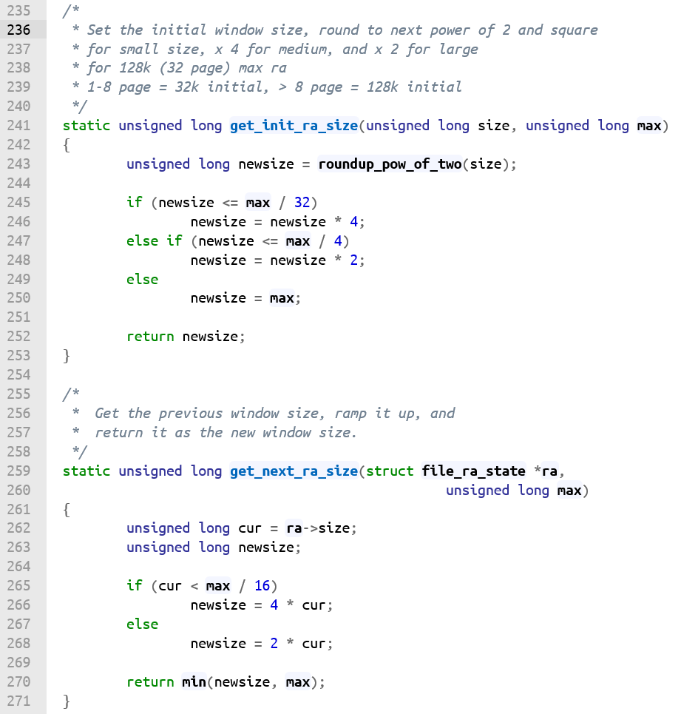
/mm/readahead.c
KCC 2018

Slide 15
/include/linux/blkdev.h?
KCC 2018

